Slide 1
This Year in Calvino
Emanuele Carlini, Alessio Sacco, Andrea Valtellini, Rayan Chafik, Efrem Baccigalupo, Matteo Giannini, Alberth Martinez, Stefano Iuliano

Slide 2

The first days at school
Rayan Chafik
I am a shy guy in fact I spent three years of middle school like a hell.
I was always alone for my weight, and nobody spoke to me.
But this year I haven't decided to do like past years. In short, the first days of school were beautiful so now I really like this group.

Slide 3
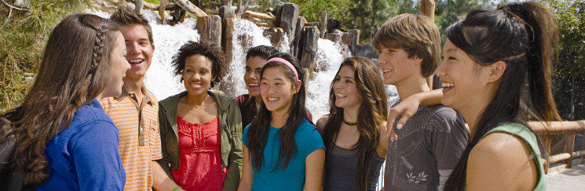
Discovery new Classmates
Alessio Sacco
My biggest fear for the high school it was this: How my new classmates will be?
I was terrified that they were grampy or that wouldn’t get along with them, fortunately I made a mistake.
I think I've the possibility to change some classmates I'd change nobody because a school class is like an ecosystem: everyone has it own tasks and removing one of this elements, even apparently useless, you would upset the ecosystem.

Slide 4
Beautiful moments
Andrea Valtellini
We are almost at the end of the year and we have spent many beautiful moments together:
Renovation; Guidarini’s prof (technical drawing professor) proposed to renovate the classroom.
Panettone; A Tuesday Rayan, after arriving late, brought a whole panettone with him. During the break Rayan wanted to eat it and share it with others. But for the prof that is illegal.

Slide 5
Beautiful moments
Stefano Iuliano
Another beautiful moment is when Simone got angry with his paw because the prof had written in italics all the tests and you did not understand anything of what was written so he kept asking what was written.
Prof Zampella then got angry for too many questions and Simone sent her to that country. that day he took a note and risked going to the presidency.

Slide 6
Bad times
Efrem Baccigalupo
This year we had some difficult moments, for example, at the beginning of February we discussed with a teacher
Another bad moment was the beginning of December when as a joke we hung a sign with some rules that were not very nice.
Only at that point did we understand the enormous mistake we made

Slide 7

Bad times
Alberth Martinez
Our class had bad moments, like one classmate punched and pushed two of our classmate one that happened a lot of time ago and one recently.
We had different time that the principal come on our class but for now none of our classmates got suspended but someone have a lot of note and a lot of classmates are in a risky situation.

Slide 8
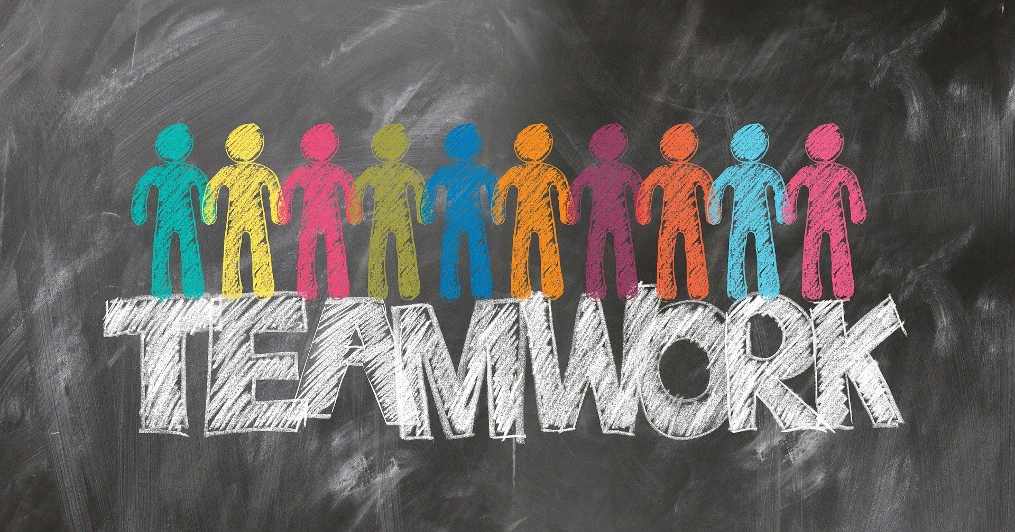
Group Works
Emanuele Carlini
This year we also did many workshops and group assignments covering many topics such as: Cyberbullying, Disabled people in sports, Pollution and global warming
I really like these "challenges" because they test all of us.

Slide 9

Things to improve
Matteo Giannini
There are some aspects of this school year that i would like to change, they're the following:- According by me, some subject gave us a lot of homework for the weekend. I would propose to increase the explanation time in class for a better reviewing the arguments to match the general understanding- Some subjects, planned only two tests in the whole yearI would propose to increase the number of tests that we'll do in the whole year to have the possibility to study less- Due to the Covid-19, we can't interact with each others no more, so se get bored in the interval because in spring if there is a nice day we would like to go out of the school for the intervalIt would be nice if next year we could get out of our classroom during interval to create some time for students to socialize with each other from other classes.

Slide 10
Thanks for your attenction
☺

